Slide 1
Application of SOM to Pen-Based Recognition of Handwritten Digits Data
By
Behnoush Abdollahi
b.abdollahi@louisville.edu

Slide 2
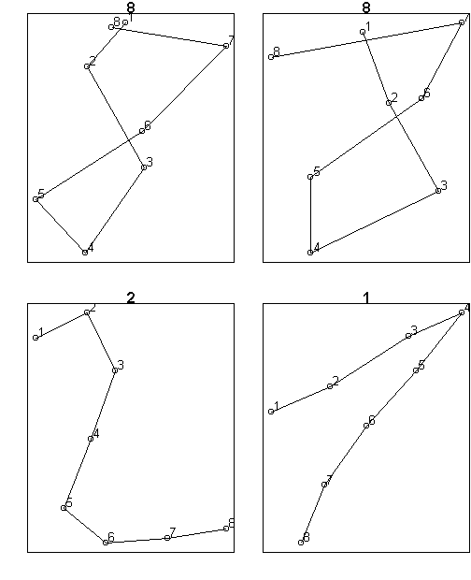
Problem Statement
Data Set: Pen-based recognition of handwritten digits from UCI online repository
7494 samples written by 30 writers
16 attributes: x and y coordinate information of 8 points

Slide 3
Selected Method: SOM
Clustering: looking for patterns in the dataset
What are different style of writing a digit?
Self Organizing Maps (SOM)
Clustering method to produce a low dimension of the input samples and group similar inputs together
Useful for visualization
Simple to implement

Slide 4
Implementation
Language: R
Toolbox: R studio
Package: {kohonen}
Function:
som(data, grid, rlen, alpha, radius, init)

Slide 5
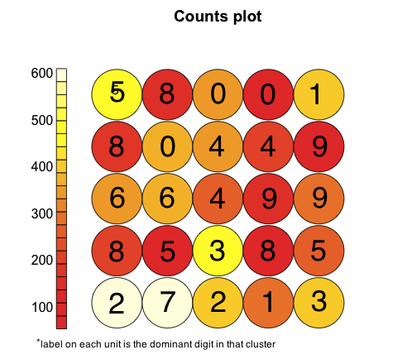
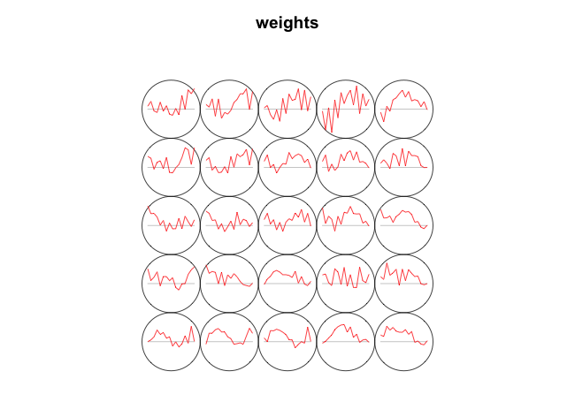
results

Slide 6
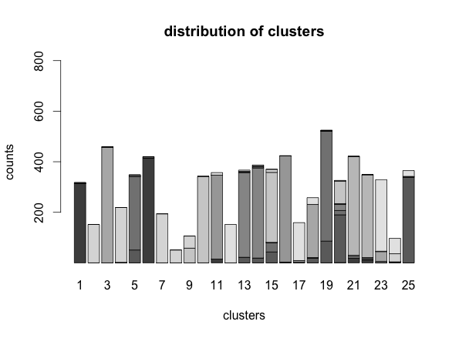
5 by 5 grid

Slide 7
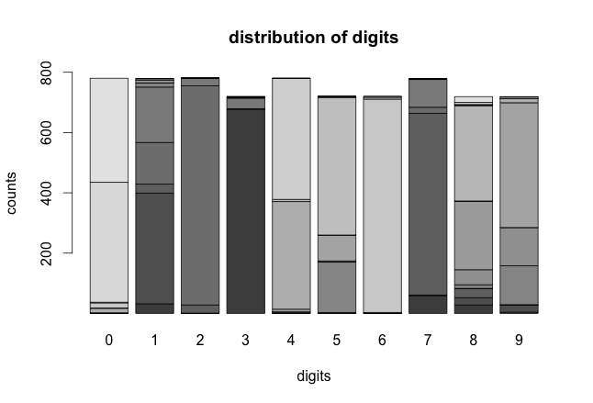
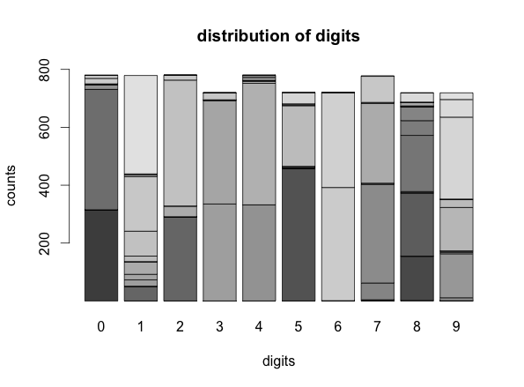
4 by 4 grid
5 by 5 grid

Slide 8
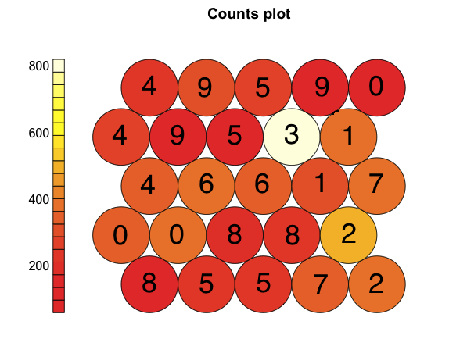
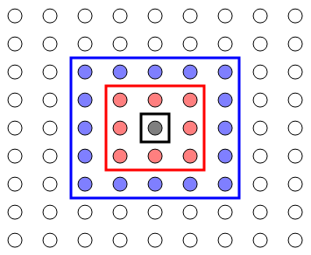
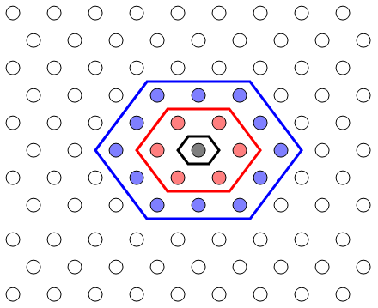
topology

Slide 9
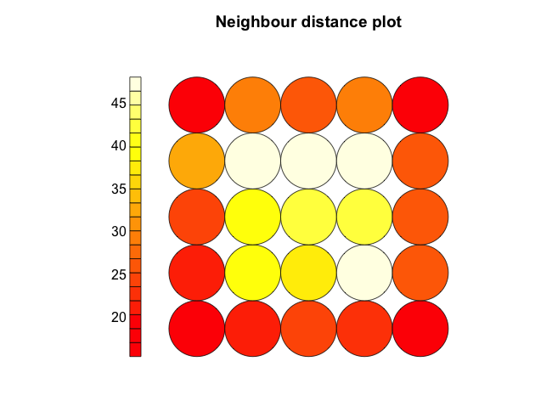
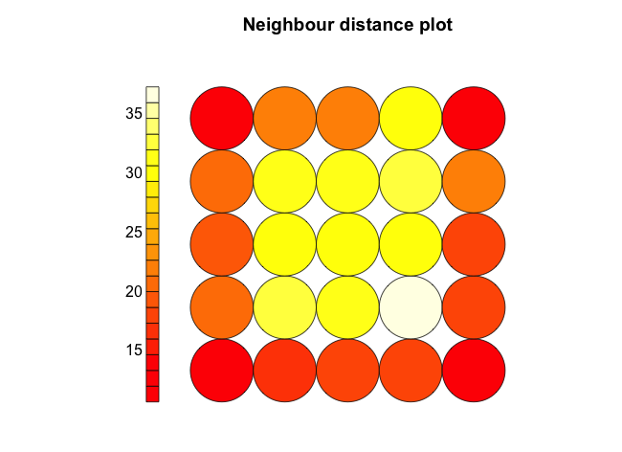
radius

Slide 10
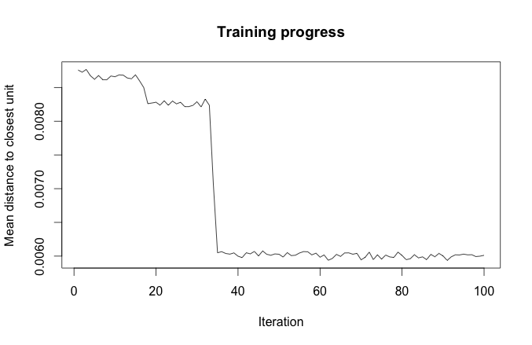

Slide 11

Questions?
Code available at:
 | https://github.com/behnoush/SOM
 | b.abdollahi@louisville.edu

